Slide 1
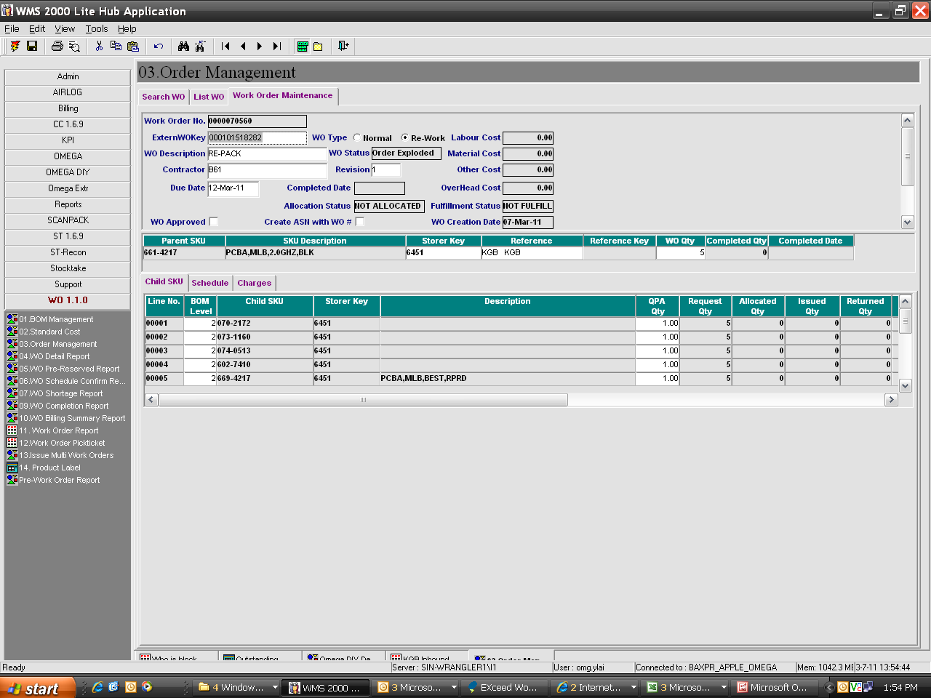

Slide 2
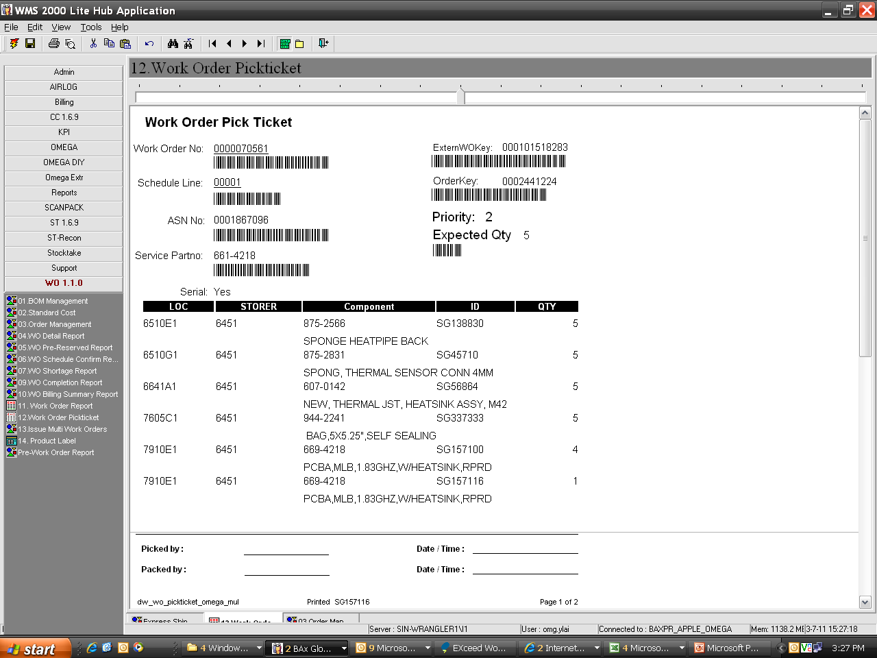
Pick ticket only print the allocated qty, we require to print the BOM list in separate sheet.

Slide 3
Printed the ASN report combine with work order pick ticket

